Slide 1

Beyond the Clouds: Navigating the Climate Frontier
Climate Onset Detectives

Slide 2
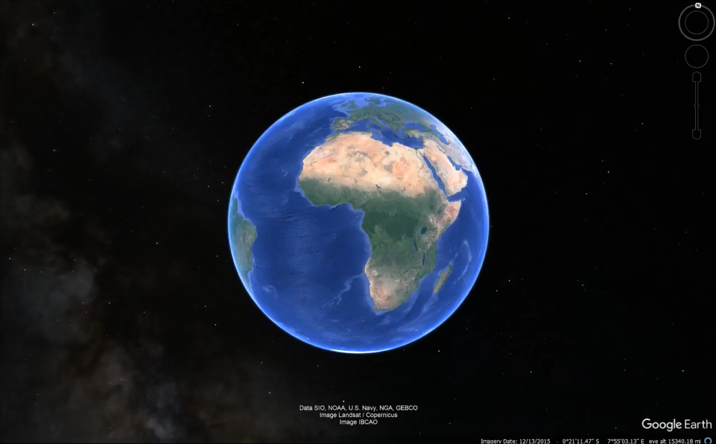

Slide 3
Introduction
Climate Onset Detectives
Team Members
Class Information
Sanchit Tomar – Project Leader
Odbileg Erdenebileg
Yunkai Yao
Edward Cogan
IST 659
Section M002
Professor – Shruti Varma
svarma@syr.edu
Dataset Information
https://power.larc.nasa.gov/data-access-viewer/
NASA/POWER CERES/MERRA2 Native Resolution Daily Data
Dates (month/day/year): 11/01/1983 through 11/01/2023
Location: Latitude 43.0345 Longitude -76.1372
Elevation lat/lon region = 222.4 meters

Slide 4
Introduction
Research Information
The primary goal of this research project is to investigate local climate patterns in the Syracuse University area. Our objective is to gain a deeper understanding of climate variations and their potential impacts on our region. The intent is to cover a historical period that can reveal any changes that have occurred in the climate over time.
Scope of Work
The project involved the following key activities:
Data Collection: Gathered historical climate data from reputable source, including local weather stations and relevant government agencies.
Data Analysis: Utilizing statistical and data analysis tools to identify climate patterns and trends.

Slide 5
Dataset & column
Database Information
Weather Database Covers 40 Years Of Data
The Main Database Contains 14611 Entries
8 Tables Including
Main Table
A Derived Table
Bridge Table
4 Lookup Tables
Creators Table
Columns
Date | Dew Point / Frost Point
Wet Bulb Temp | Surface Temperature
Temperature Range | Temp Max
Relative Humidity | Temp Min
Specific Humidity | Precipitation
Understanding Wet Bulb Temperature - dry bulb temperature is like the regular temperature you see on the news, and wet bulb temperature is like adding a wet cloth to see how cool it really feels outside – higher humidity reduces the cooling effect

Slide 6
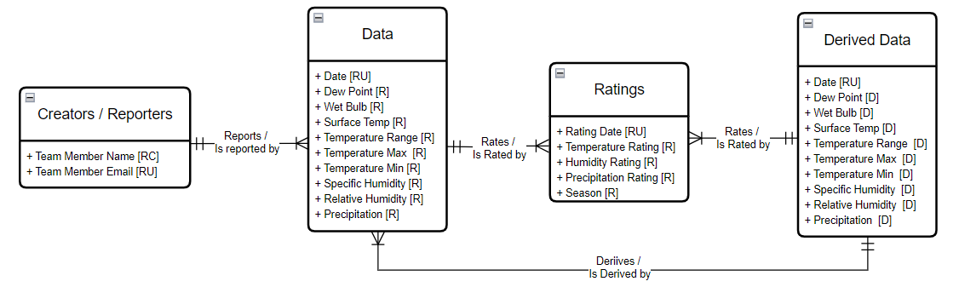
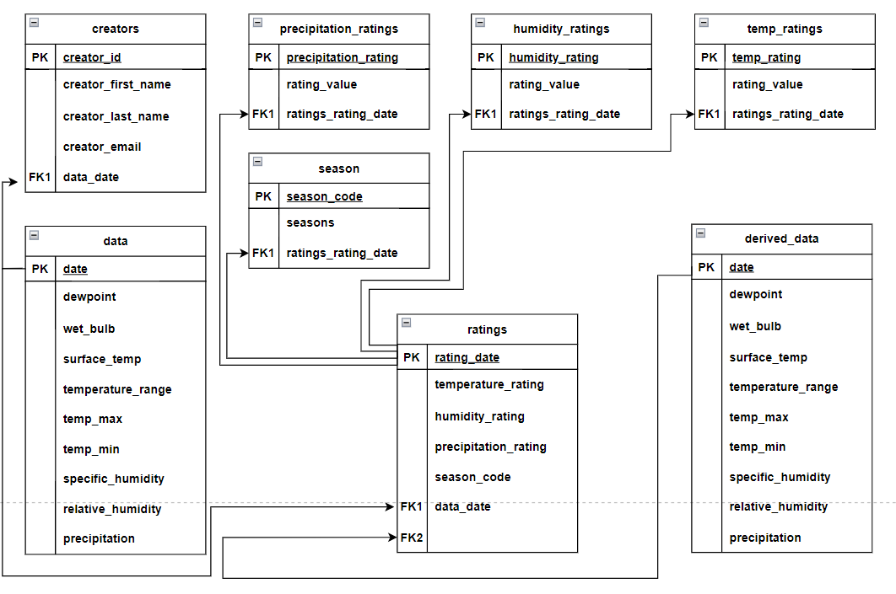
Conceptual & logical Models
Conceptual Model
Logical Model

Slide 7

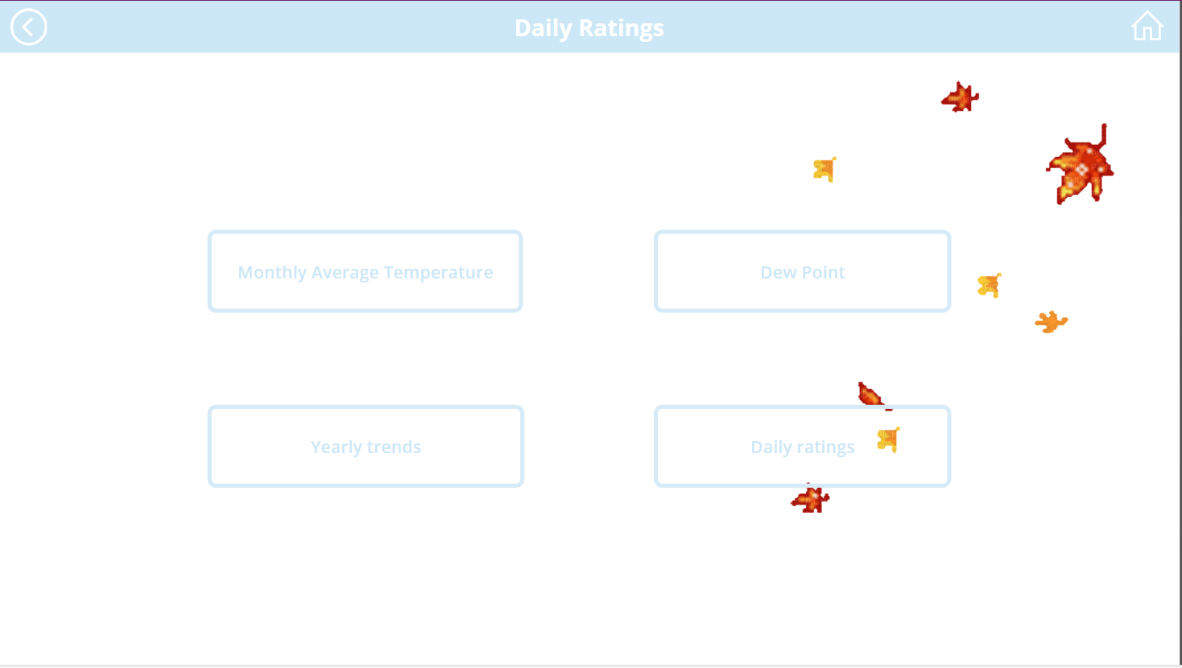
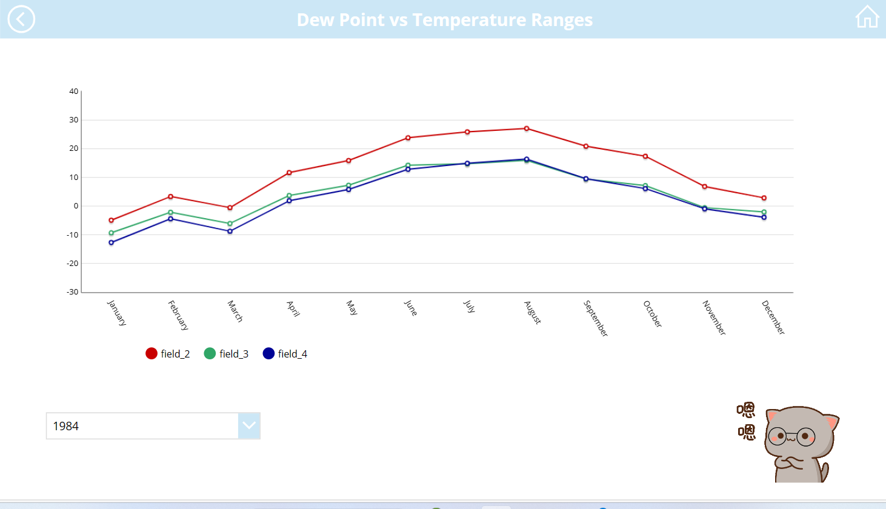
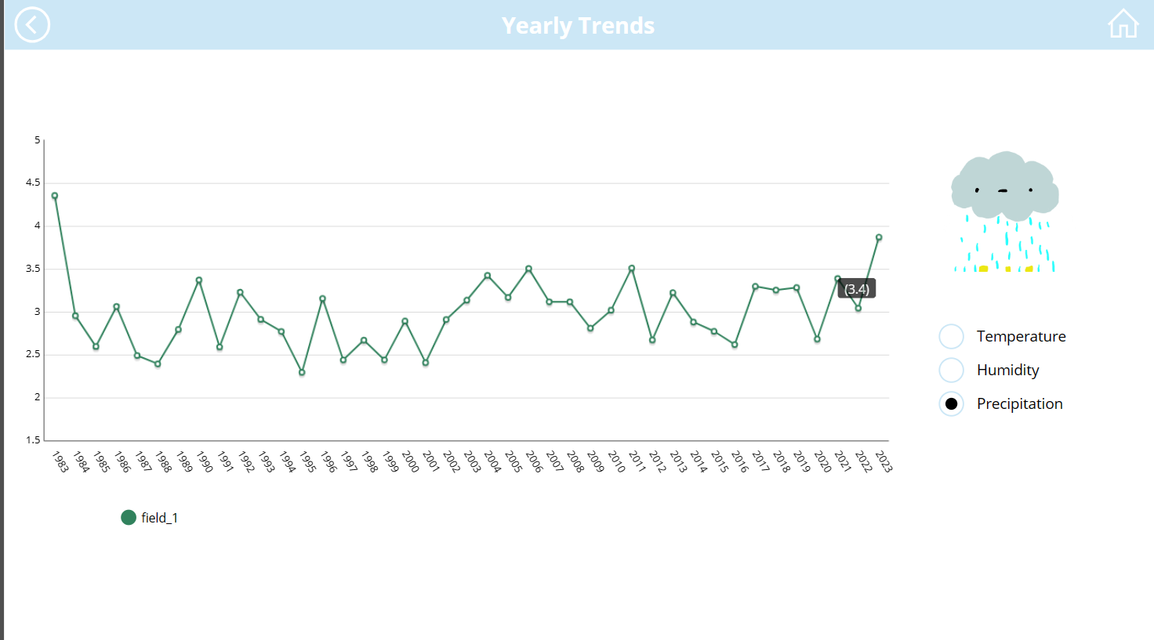
Screenshots

Slide 8

Demo
Final - PowerApps

Slide 9

Areas of improvement
We are planning to use this source code to investigate Mongolia's capital Ulaanbaatar climate patterns. The only things we need to change are to extract data from the NASA website and the rest of them same process as this work.
Furthermore, we are going to use Machine learning algorithms like Linear Regression to predict future weather.
There are a lot of things that we would like to add to the App and improve the user experience.

Slide 10

challenges
Initially, we struggled to find Syracuse weather data.
We found many resources but most of them were not useful, apart from the NASA website.
The NASA website was initially very challenging. However, one of our team member Edward was able to extract data from it. Thanks to him.
We had issues with our Azure student credits expiring. It was difficult to produce a workaround, but we were able to push through.

Slide 11
Conclusion
Important Information
We believe that this project holds significant value for the local community. By improving our understanding of local climate patterns, it will empower us to make well-informed decisions in addressing climate challenges.
Trivial Information
Weather database covers 40 years of data
The main database contains 14611 entries
Max Temp: 99.2F (37.3C) on 7-1-2018
Min Temp: -22.9F (-30.5C) on 1-27-1994
Average temp over 40 years: 47.4F (8.6C)
Data Percentage versus Time
Syracuse established:1825 (20.20%)
Syracuse University established: 1870 (26.14%)
Recorded History ~5000 years: (0.80%)

